Slide 1
Basket Analysis with Apriori Algorithm
Discovery results

Slide 2
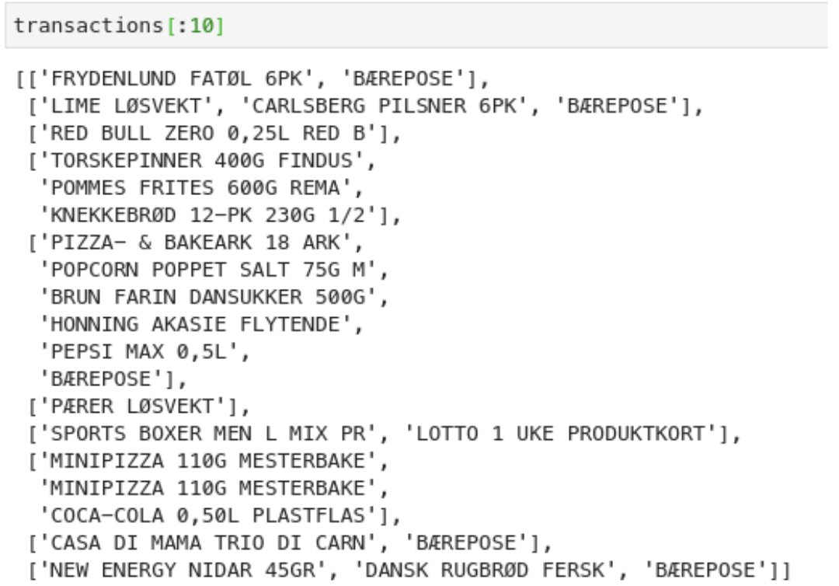
Prototyping: data
Data: 1M row dump from BQ Query, exported as CSV and grouped by the ReceiptReferenceNumber field into receipts (baskets)
After grouping: 175,183 transactions (baskets)
Library: python library apyori

Slide 3
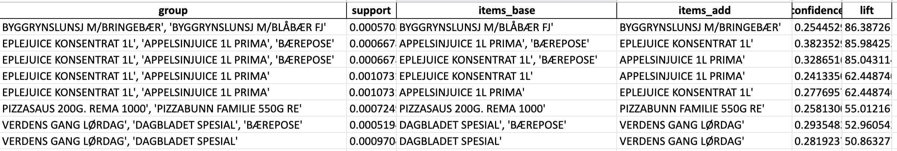
Prototyping: results
Results look like this:
...
Frequently bought together: {'AGURK STYKK', 'ALL BRAN REGULAR 500G KEL'}
This group of items occurs in 0.02% baskets
Buying 'ALL BRAN REGULAR 500G KEL' makes probability of buying 'AGURK STYKK' ~3.9x higher : probability goes from 6.08% to 23.53%
...
List of association rules with high lift and high confidence

Slide 4
Prototyping: performance
14s to compute 1,000 groups from 175,183 transactions
16s to compute 10,000 groups from 175,183 transactions
41s to compute 100,000 groups from 175,183 transactions
1h 40m to compute all groups from 3.5M transactions
Estimates show that it will fail with 100M+ baskets due to memory limits (even on large instances)

Slide 5
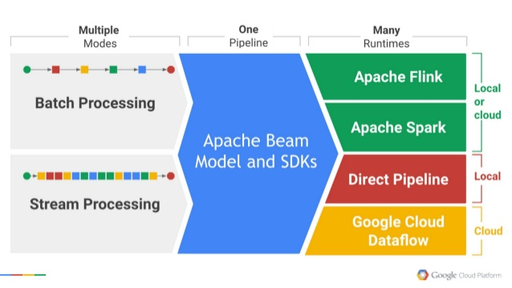
Introducing Apache Beam & DataFlow
Notes:
Low performance might be due to significant overhead in complexity with Apache Beam
and the fact that DirectRunner is a single-host environment, not designed for production use.

Slide 6
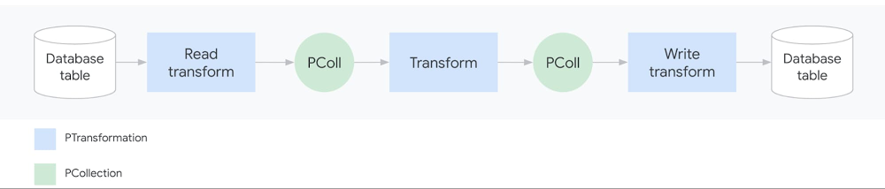
Apache Beam explained
Notes:
Low performance might be due to significant overhead in complexity with Apache Beam
and the fact that DirectRunner is a single-host environment, not designed for production use.

Slide 7
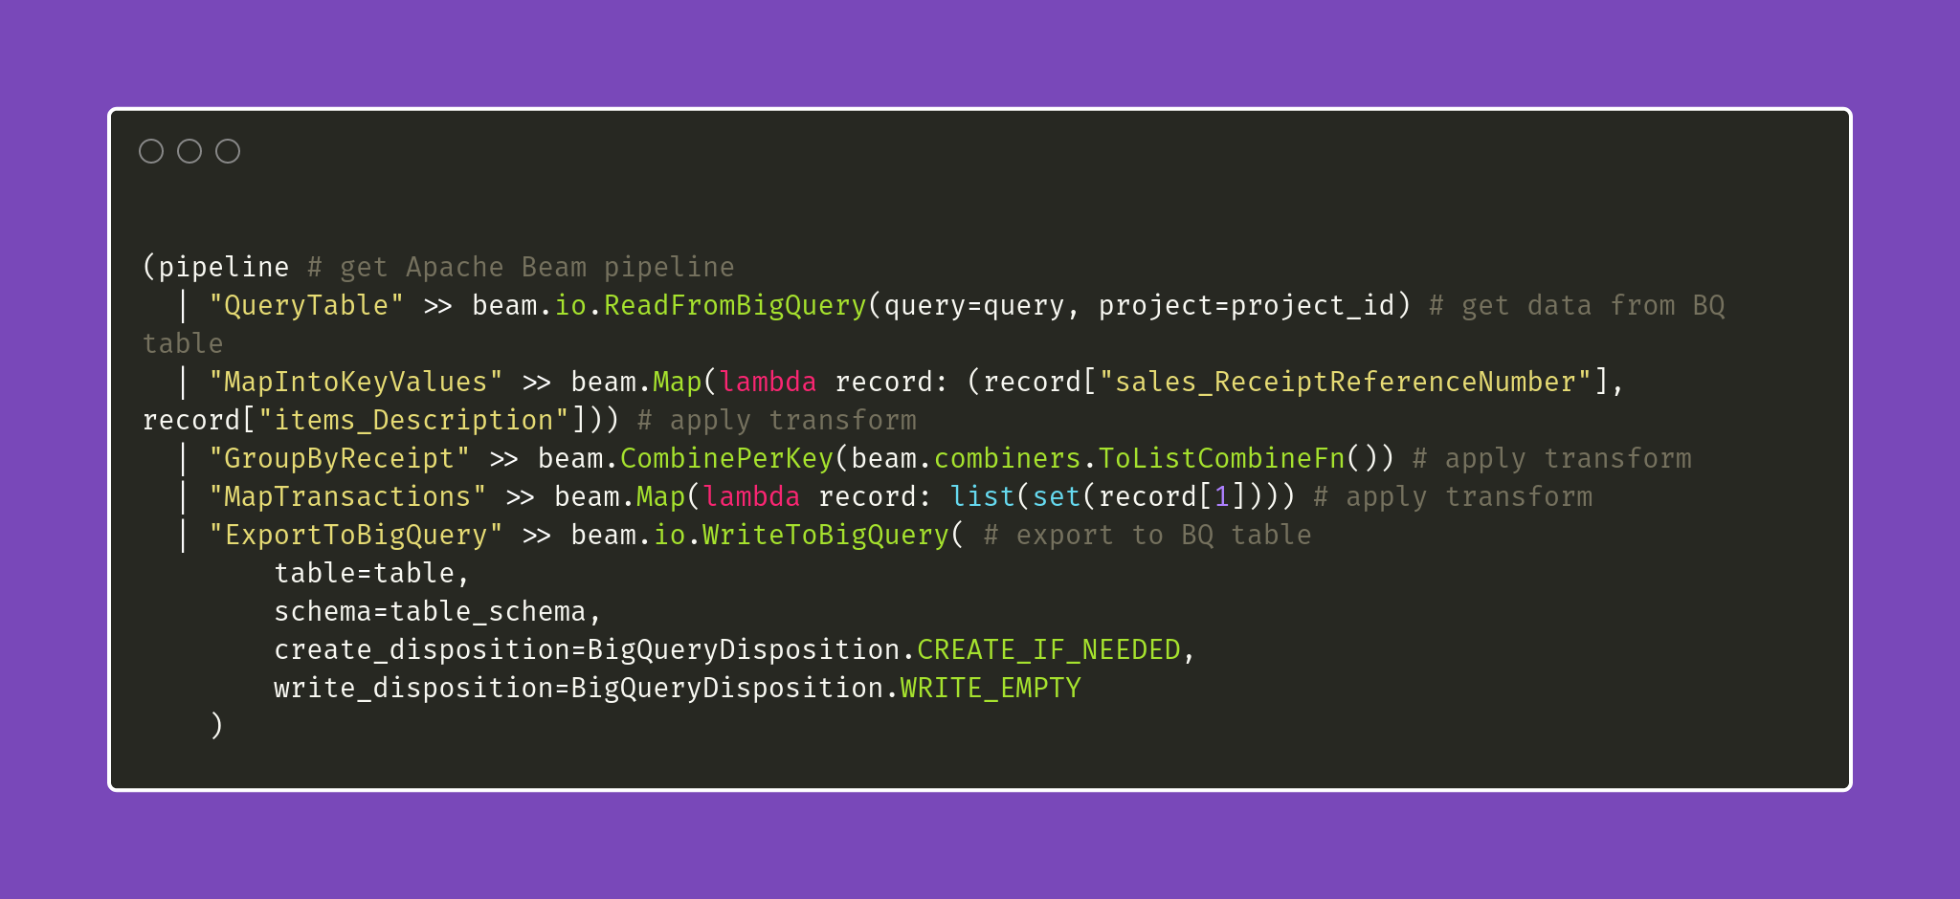
Apache Beam code example
Notes:
Low performance might be due to significant overhead in complexity with Apache Beam
and the fact that DirectRunner is a single-host environment, not designed for production use.

Slide 8
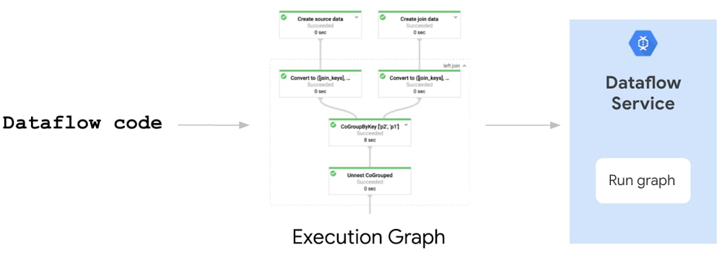
DataFlow approach
Notes:
Low performance might be due to significant overhead in complexity with Apache Beam
and the fact that DirectRunner is a single-host environment, not designed for production use.

Slide 9
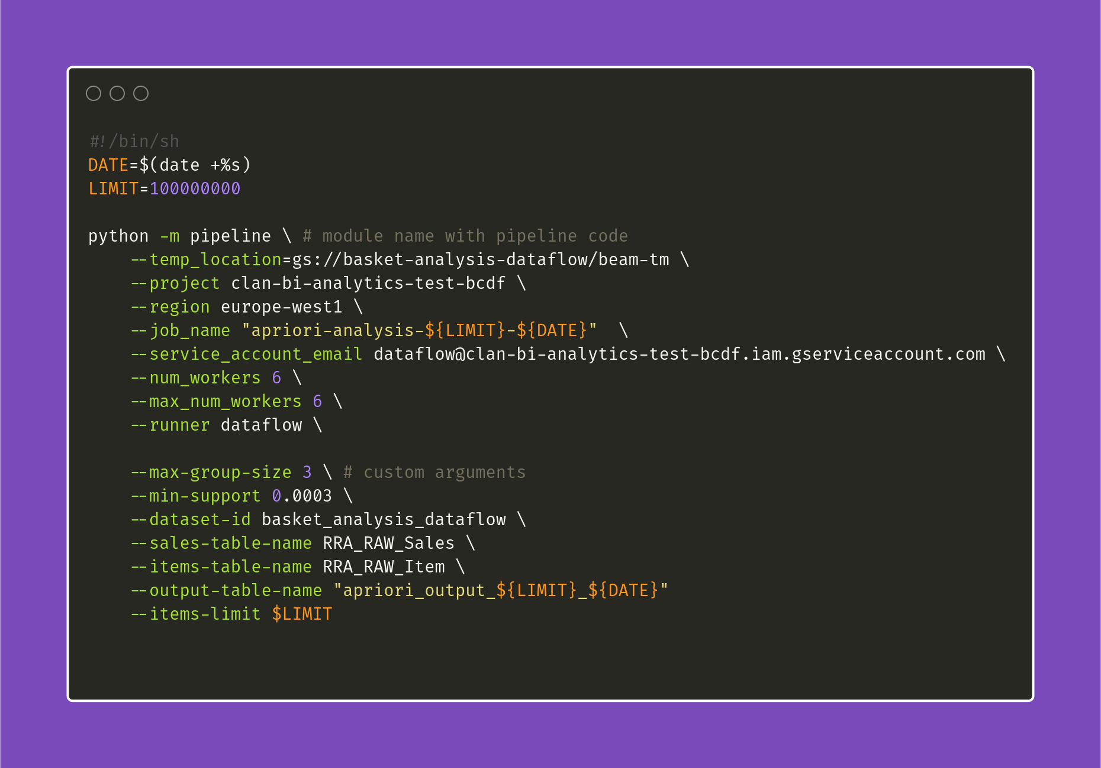
DataFlow invocation example
Notes:
Low performance might be due to significant overhead in complexity with Apache Beam
and the fact that DirectRunner is a single-host environment, not designed for production use.

Slide 10
Big Data apriori implementation
Hand-crafted Apache Beam Apriori implementation has been developed
Initial recreation uses 1M records (170k+ baskets) to evaluate and compare algorithm with original apriori
Final pipeline launched against entire dataset (3.5M transactions)
Big Query has been successfully integrated as a data sink (example of query for accessing the pipeline results)

Slide 11
Big Data: performance
Comparison with original apriori has been executed on 100K and 1M records using DirectRunner i.e. running on the working PC
Performance of Apache Beam apriori is ~20x slower.
Running Apache Beam apriori on GCP DataFlow against the entire dataset with 6 workers took 21h.
Notes:
Low performance might be due to significant overhead in complexity with Apache Beam
and the fact that DirectRunner is a single-host environment, not designed for production use.

Slide 12
Conclusions
For current or slightly larger amount of data it worth using original python library apriori algorithm. In case of amount of data would scale more than 20 times it may require running Apache Beam apriori implementation
Original apriori algorithm allows to compute “group to group” influence compared to Apache Beam apriori implementation which is developed to compute only “group to 1 item” influence.
Notes:
To handle current 3.5 M it took about 6GB of memory.
It assumes to run original apriori on 120GB+ cloud machine

